Slide 1
Lessons From Auschwitz
Nia Williams, Tink Remec, Gwen Wright, Oliver Shaw

Slide 2
The Holocaust
The mass murder of approximately 6 million Jews by the Nazis and their collaborators. Although certain other groups were victims of Nazi persecution and genocide, only Jews were targeted for complete destruction. This is why we will be telling the stories that millions of Jews were unable to.

Slide 3
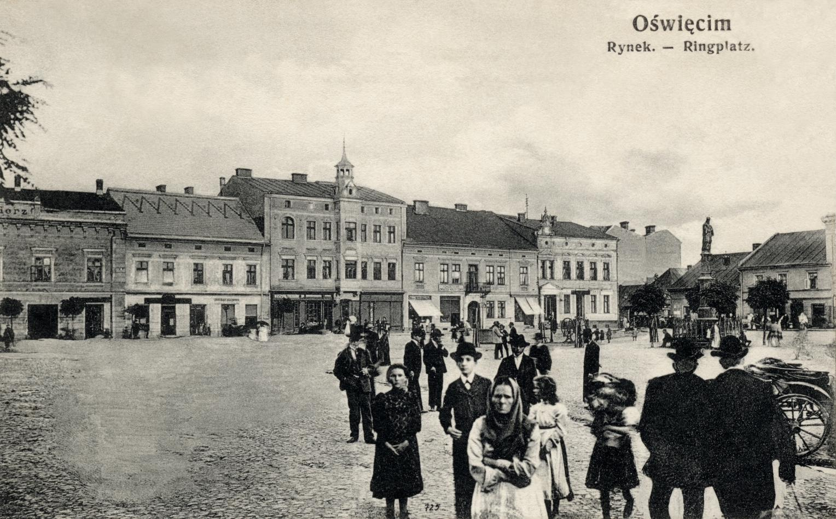
What was life like for the Jewish community pre-war?
The Herz Hotel
It would be difficult to just give one example of what life was like for the Jewish people before the war, because of how diverse and unique each community is.
The largest Jewish community was in Poland, being home to 3,000,000 Jews.
One town in Poland with a thriving Jewish community, Oświęcim, would later be known as the site of the Auschwitz concentration camp.
This was a hub for the union of Jewish and Christian communities in the centre of Oświęcim. It stood 3km away from where Auschwitz was later built.

Slide 4
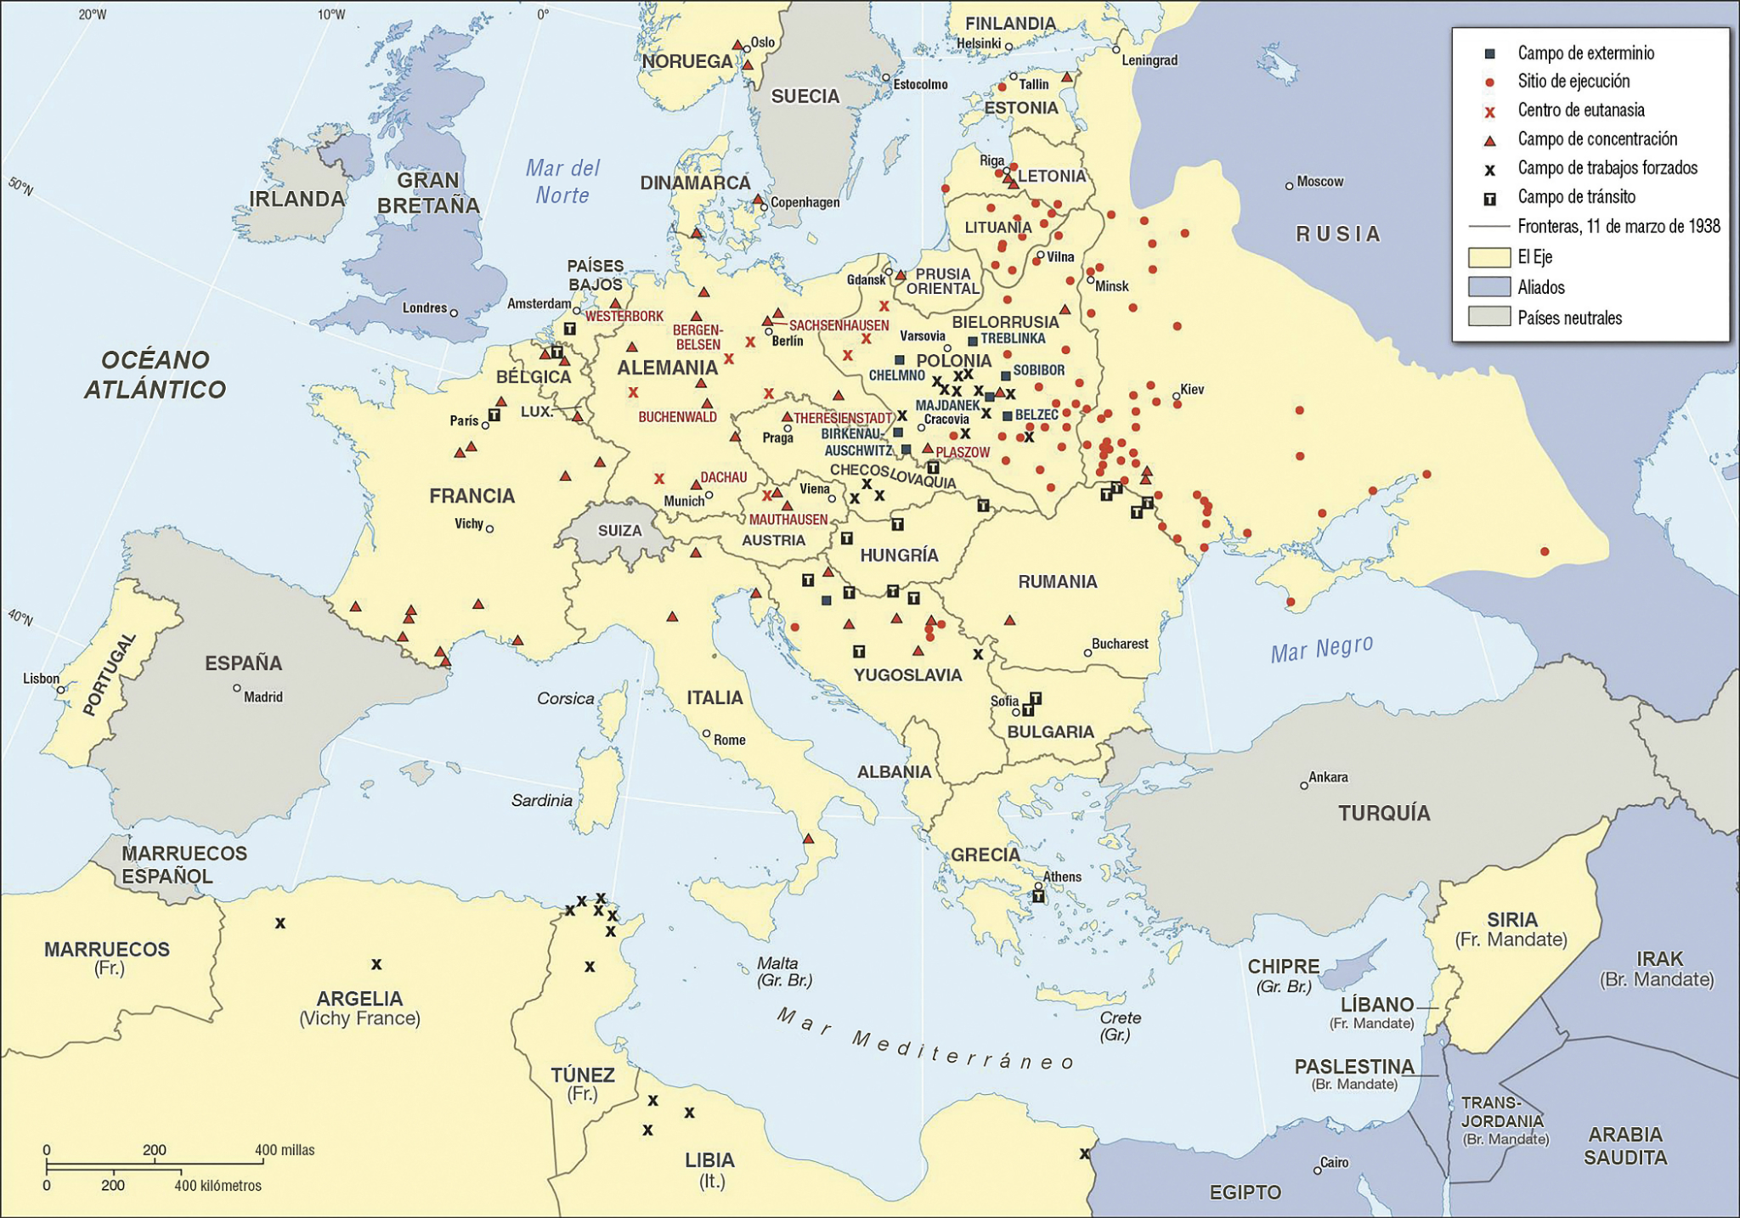
Perpetrators, Collaborators and Bystanders
It is widely known that the Nazi’s were responsible for the Holocaust, we would call them the perpetrators. However, we must realise that for such a large scale attempt to wipe out an entire community of people, they couldn’t have worked alone. We call those who supported in the holocaust, the collaborators. Many of Germany’s allies in the war supported with the deportation and murder of many Jews. There were 500,000 clerical and 900,000 manual workers in the railway network, which was key to transporting Jews to the camps. The true number of bystanders to the holocaust is unknown, throughout the Holocaust not a single government, social group, scholarly institution or professional association in Nazi-dominated Europe openly declared its solidarity with the Jews.
A map showing the distribution of concentration camps across Europe

Slide 5
It is important to not only remember the individual lives that were lost during the Holocaust but to also learn from it.
So how is the Holocaust relevant today?
Genocides are still going on in the world today.
To make sure it’s never forgotten or denied.
In order to prevent future genocides.
Learning from the Holocaust will help to make sure history does not repeat itself.

Slide 6
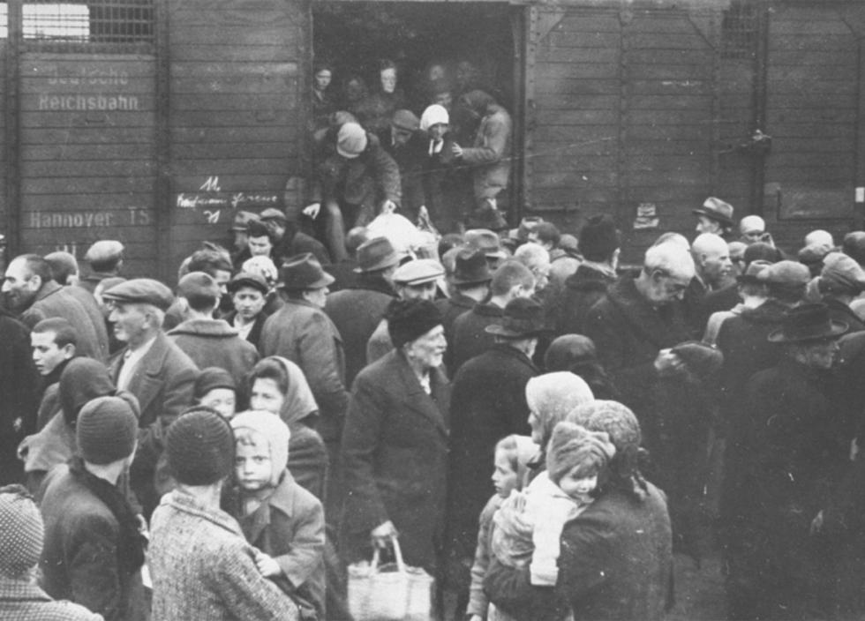
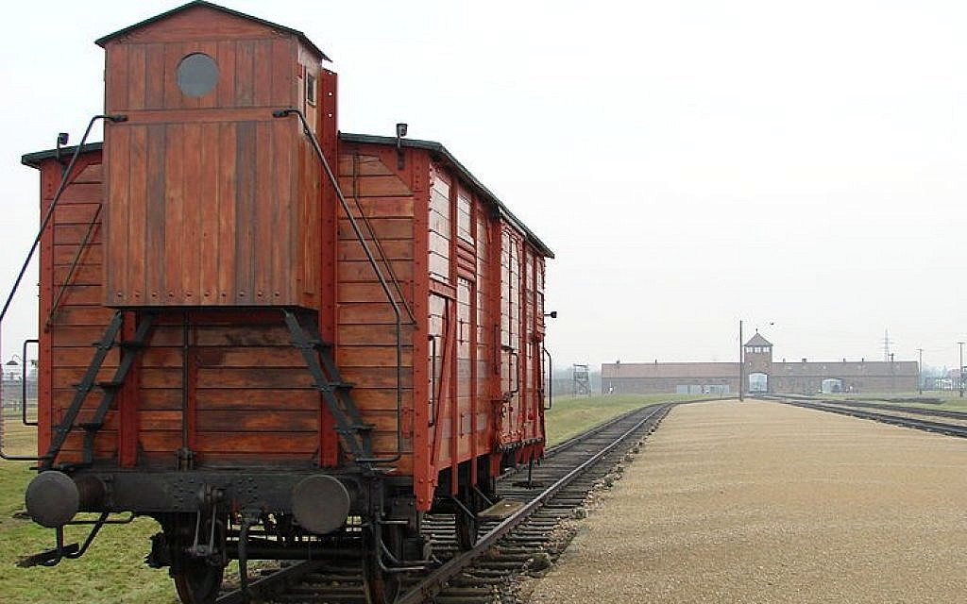
Transport and arrival
As soon as trains arrived a selection would take place.
As many people as possible would be crammed into filthy railway cattle wagons without ventilation, water or food.
This selection would split and break families forever. Women and children would be sent to one side and men to the other. - last time they would ever see each other.
Those who were fit for work would then be sent to one side while those who weren’t would be sent straight to the gas chambers.
They would often have to be travelling for days until reaching their destination, of which was unknown to them.
Children under the age of 14 would almost always be sent to be gassed immediately.

Slide 7
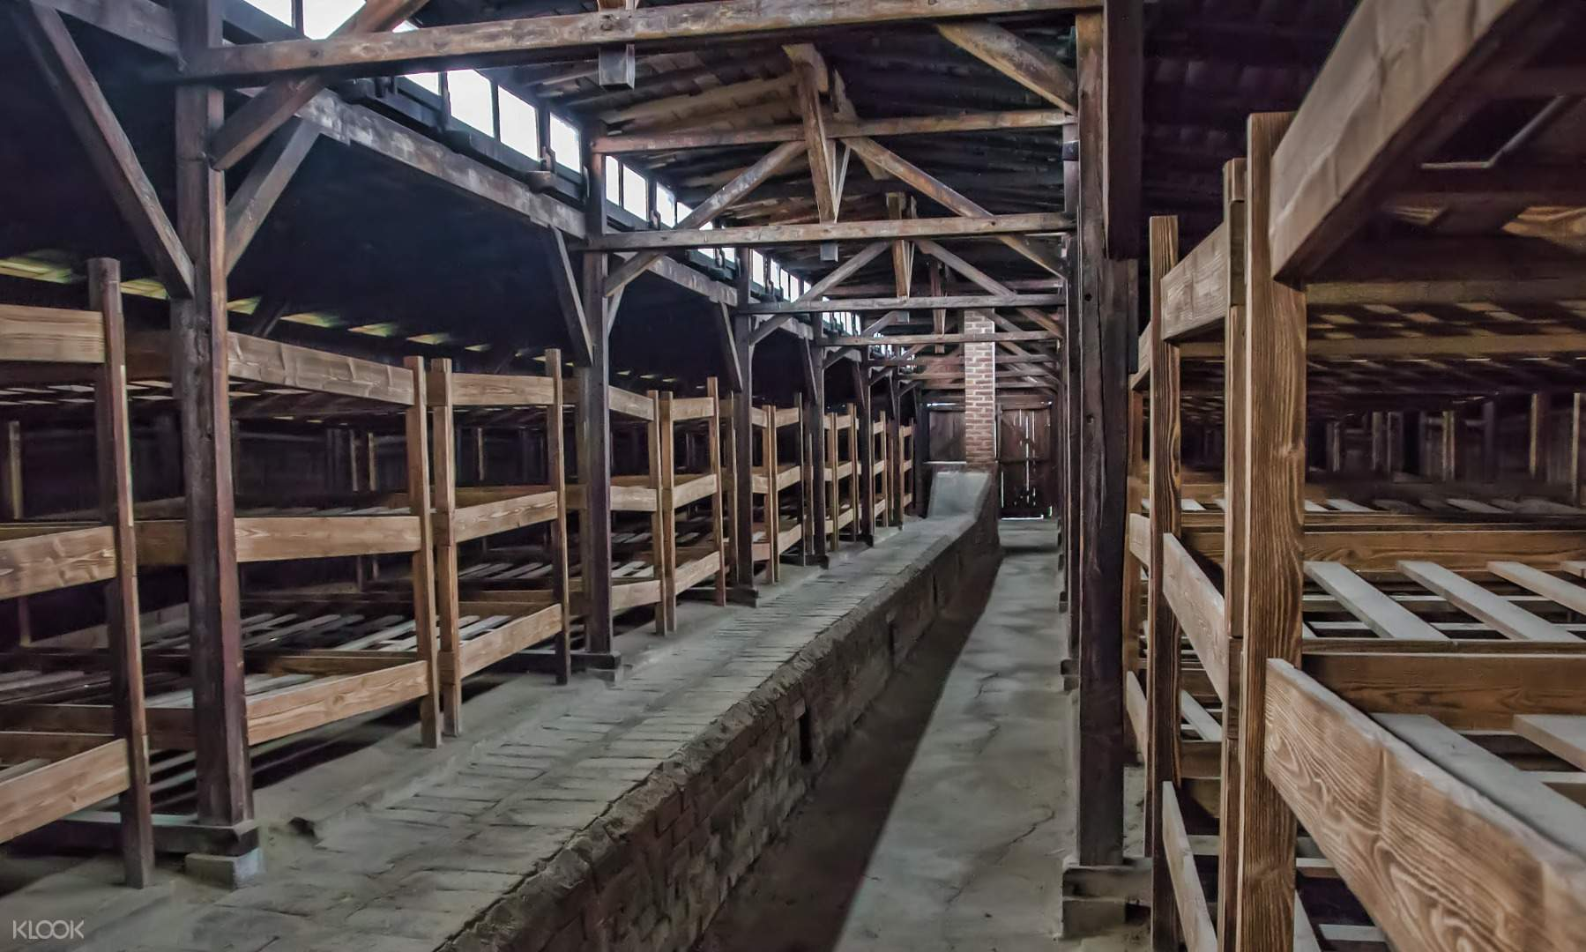
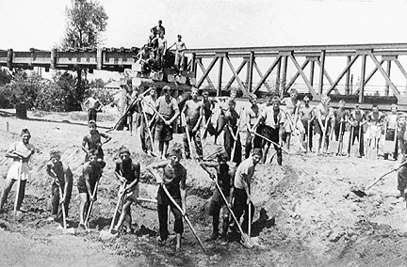
Living and Working Conditions within Auschwitz-Birkenau
The sleeping quarters in Auschwitz was a horse stable design, with bunk beds three levels high in a shelf design. This resulted in very cramped, poor and uncomfortable conditions while being sweltering hot in the summer and bitterly cold in the winter.
The working conditions with any work camp were horrendous with very little water and food per day. They would have watery soup and small piece of bread to get through a day of back breaking work. One survivor story told by Eva Clarke on behalf of her mother, Anka, emphasizes the malnourishment with in the camp. Anka was only 5 stone while nine months pregnant.

Slide 8
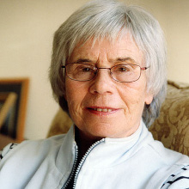
Survivor Story from the Holocaust
It is important to remember that behind every single story there is a name and a family affected by the events of the holocaust
This is Kitty Hart-Moxon OBE
Born in Bielsko 1926.
Kitty and her mother were the only survivors of their family. 30 members of her family perished in Auschwitz-Birkenau. She now lives in the UK. After liberation Kitty felt it was her duty to speak out about her past and warn of the consequences of intolerance, racism and hatred. For years, Kitty has done exactly that.
Kitty and her mother were imprisoned and sentenced to death, but their sentence was later commuted to imprisonment in Auschwitz-Birkenau. They arrived in Auschwitz on 2nd April 1943. Kitty was only 16 when she was sent to the camp.
During her time, Kitty was witness to the relentless killings that took place. Kitty and her mother were moved from Auschwitz and stationed at different factories as workers, mostly underground. Eventually ending up at Bergen-Belsen after a treacherous journey. This camp was liberated on 14th April 1945.

Slide 9
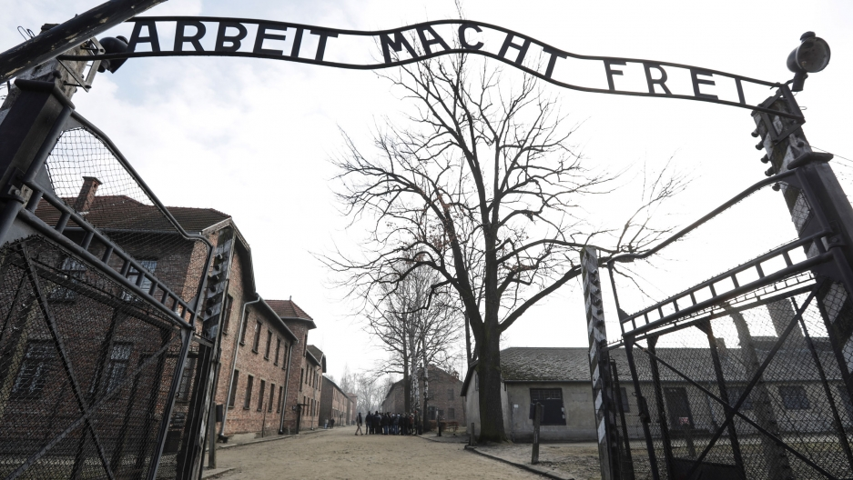
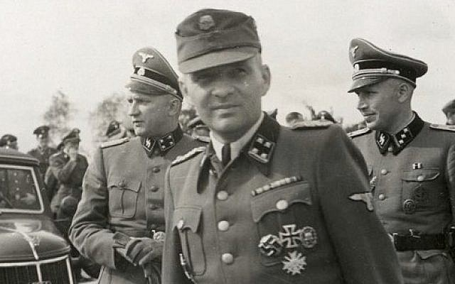
The Choices of the Nazis and their Collaborators
It is integral to remember that every perpetrator had a name and all made conscious decisions to partake in the events of the holocaust.
Rudolf Hoss was a German soldier and Nazi who was commandant of the Auschwitz concentration and extermination camp complex (1940–45) during a period when as many as 1,000,000 to 2,500,000 inmates perished there.
Rudolf lived in Auschwitz with his family in a house that was only a few metres from the nearest gas chambers.
Rudolf Hoss
However, it’s important to note that there were many enablers of the Nazis e.g train drivers, that had no choice but to do their jobs for financial reasons as they had to support their families and stay alive.

