Slide 1
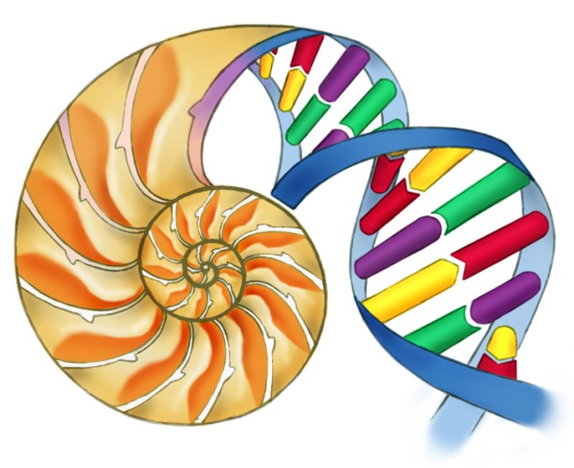
A level Biology

Slide 2
Teaching Staff
Mr D Thomas
Mrs S Cornell
Miss Nia Davies
Biology is normally put into two option blocks ,therefore each group will have two teachers.

Slide 3
Summary of Course Content
AS Level
Unit 1
Biochemistry
Cell Ultrastructure
Enzymes
DNA
Cell Division
Protein Synthesis
Unit 2
Biodiversity
Classification
Transport systems
Gas exchange
Nutrition

Slide 4
A2 Level
Unit 3
Respiration
Photosynthesis
Microbiology
Homeostasis
Nervous System
Unit 4
Reproduction
Genetics
Evolution
Immunity
Unit 5
Practical Examination

Slide 6
Assessment

Slide 7
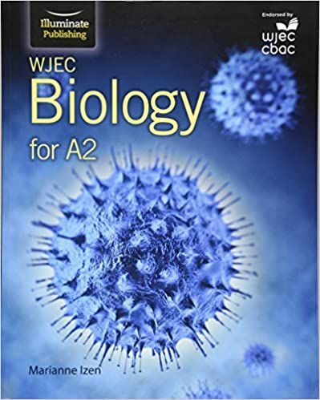
Resources

Slide 8
A minimum of a B grade in double award or separate science biology. A minimum of a B grade in GCSE mathematics .
Course Requirements

Slide 9
Results
Year | A | B | C | D | E | U | %A-B | %A-C | % PASS
2005 | 4 | 8 | 5 | 0 |  |  | 70 | 100 | 100
2006 | 13 | 3 | 6 | 3 |  |  | 64 | 88 | 100
2007 | 11 | 6 | 4 | 2 | 1 | 1 | 68 | 84 | 96
2008 | 10 | 9 | 7 | 3 |  |  | 76 | 90 | 100
2009 | 4 | 10 | 4 |  | 1 | 1 | 70 | 90 | 95
2010 | A*4 A 6 | 9 | 6 | 5 | 2 | 2 | 56 | 74 | 94
2011 | A*3A8 | 7 | 3 | 1 | 5 | 1 | 64 | 75 | 96
2012 | A4 | 2 | 8 | 5 | 2 | 0 | 28 | 71 | 100
2013 | 7 | 7 | 5 | 4 | 5 | 1 | 24 | 65 | 97
2014 | 6 | 17 | 8 | 8 | 4 | 0 | 53 | 71 | 100
2015 | 4 | 8 | 3 | 7 | 8 | 0 | 37 | 50 | 100
2016 | A*2 A 8 | 5 | 11 | 2 | 2 |  | 50 | 87 | 100
2017 | 2A* 4A | 2 | 4 | 1 | 2 |  | 40 | 80 | 100

Slide 10
Student comments
Biology is undoubtedly the most factual and interesting subject that I have ever studied. A level biology is challenging, yet fascinating. If you enjoy learning about the processes going on in the human body or are curious about other areas of biology such as plant biology and nutrition, then I thoroughly recommend studying biology at A level.
The teachers are great too!
Luke Hall
Year 13
I have always been interested in biology and the human body fascinates me. Studying A level biology has expanded my knowledge of the subject and has challenged me due to the intensity of the course. If you are prepared to work hard then biology is a good option choice.
Yasmin Hamid
Year 13
A level biology is challenging but incredibly thought provoking. It provides many opportunities to learn about different areas of biology and relate them to everyday life. I would definitely recommend taking biology if you are hard working , but it is a big step up from GCSE.
Arianne Turner
Year 13

