Slide 2
Aim
To understand what Earth Day is.
To understand how climate change can affect us.
To understand how we can help to ‘Restore Our Earth’.

Slide 3
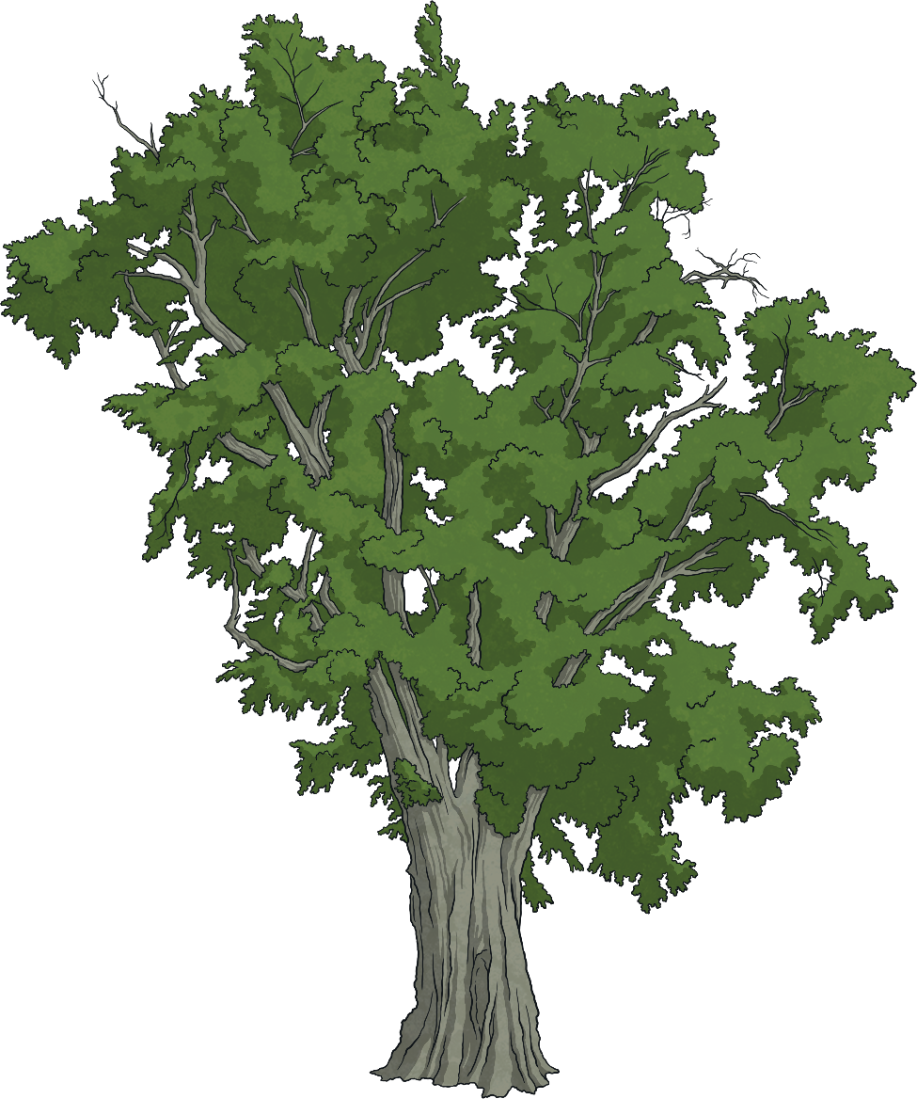
Today, We Will Think about…
What is Earth Day?
What is the theme for Earth Day 2021?
How does climate change affect us?
How can our earth be restored?
What can you do to help?
Reflection

Slide 4
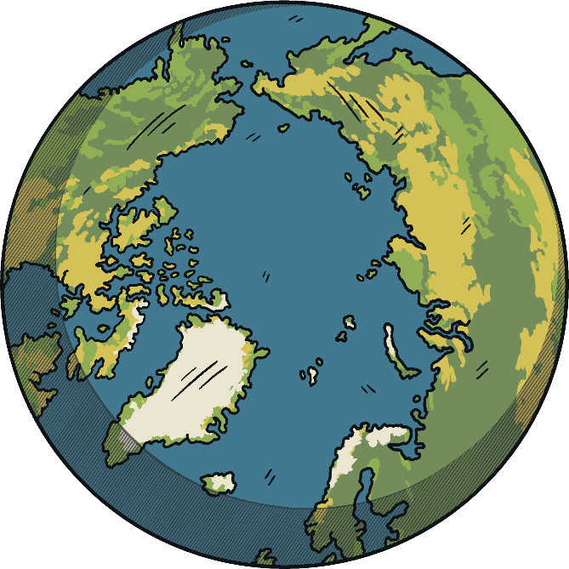
What Is Earth Day?
Earth Day is an event which takes place every year on 22nd April.
1970 was the first year Earth Day was held and since then, people have shown their support for the environment by becoming involved.
On this day, awareness of how we can look after our planet is raised and people are encouraged to protect the earth by attending events.
This year will be the 51st Earth Day. A three day event is being held from 20th April, focusing on climate action, finishing on Earth Day.

Slide 5
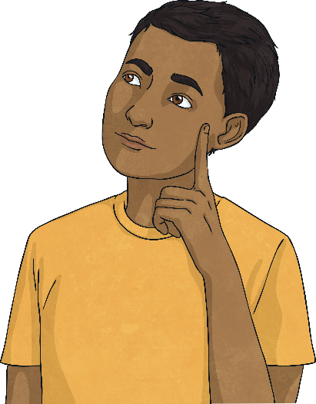
Why Is Earth Day Important?
What do you know about climate change?
Why do you think Earth Day is important?
While there have always been natural changes to the earth’s climate, human activity is causing the temperature to rise to a dangerous and unsustainable level – this is climate change. This means that ecosystems and species cannot continue to thrive.
Earth Day encourages us to look after our planet and reminds us that we need to make changes to our lifestyle if we want to protect our planet and our futures.
Did You Know…?
If we don’t take action on climate change, we could lose almost 50% of species from the world’s most important natural areas.

Slide 6
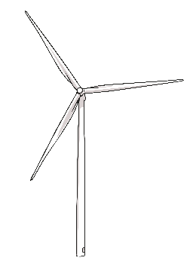
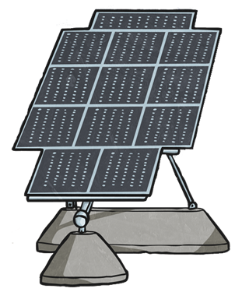
What Is the Theme for Earth Day 2021?
Restore Our Earth
The aim for this year is to think about ways that we can restore the world’s ecosystems using green technologies.
This doesn’t mean you can’t venture into nature though! Everyone is still being encouraged to do their part to support local communities, especially those who may be affected more than most from climate issues.
Due to social distancing this year, a live digital event is being run from 20th - 22nd April and will include workshops, performances and discussions.

Slide 7
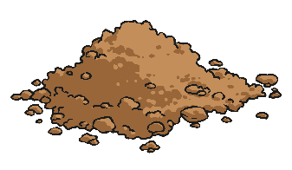
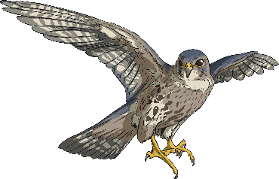
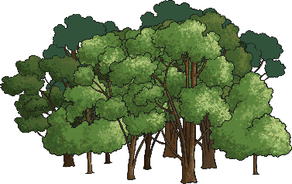
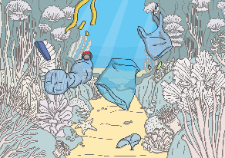
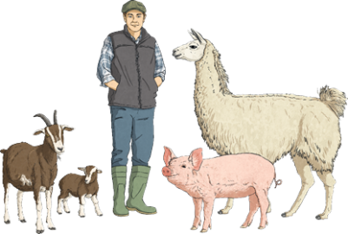
Restore Our Earth
What does restoring our earth look like?
For governments, businesses, scientists and organisations, helping to restore the earth begins with a move to using green technologies to help:
conserve and rebuild soils;
restore wildlife populations;
restore the world’s ecosystems and forests;
rid the world’s oceans of plastics.
improve farming practices;
As individuals, our impact may be a little smaller but don’t worry - there are always things you can do to play a part in restoring our earth. Find out some of these ideas on the next slides!

Slide 8
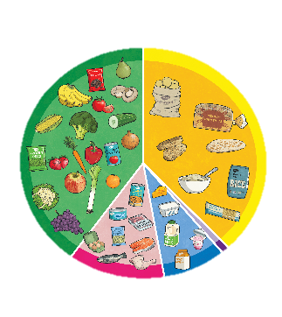
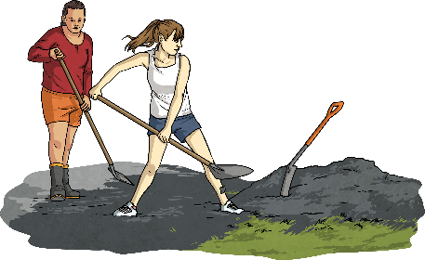
What Can We Do to Help?
Click on some of the ideas below to learn about what we can do to help restore our earth:
diet
recycle, reuse and reduce
travel
other
trees
volunteering

Slide 9
Diet
back
What we eat and where our food comes from has a huge impact on the environment.
The process of deforestation and the methane gas produced from livestock has a great impact on the environment. Cutting down on the amount of meat we eat can lessen this impact.
Did You Know…?
According to a report by the UN, at least 18% of all greenhouse gas emissions worldwide are produced by livestock – that’s more than the entire transportation sector!
Sourcing foods locally and eating seasonally can also help keep emissions down, as there would be less energy used in transporting food from other countries.

Slide 10
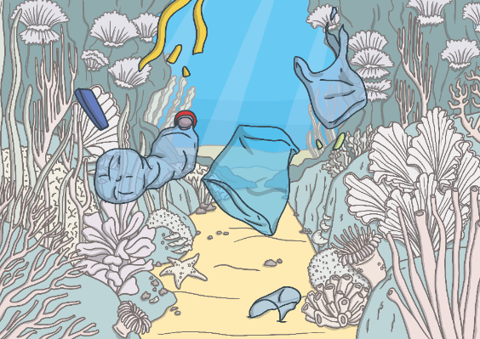
Recycle, Reuse and Reduce
back
Plastic pollution is another serious issue our planet is facing. The way plastic is created, harmful gases are released into the environment. Plastic doesn’t decompose which means it pollutes our land and oceans and takes hundreds of years to disappear.
What can you do to help?
Recycle – If you have to buy something made from plastic, check that it has the recycle sign and the correct number (1 & 2) so that you can recycle the rubbish. Also, try to buy items that are made from recycled materials.
Did You Know…?
Every year, around 8 million pieces of plastic enter our oceans.
Reuse – You could even try and use the item in a different way so you don’t throw it out! Rather than buying lots of bottles of water for example, you could invest in a long-use bottle that will last you for years.
Reduce – Use less plastic! Buy a fabric shopping bag rather than using plastic bags. Buy a reusable bottle so you don’t keep buying single use ones.

Slide 11
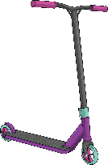
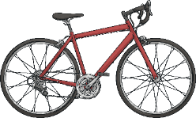
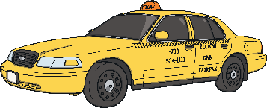
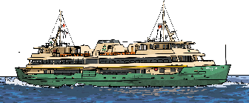
Travel
back
How many modes of transport can you think of?
Think about the different journeys you take in your week. Could you cut down on driving and walk or cycle instead?
Did You Know…?
Transport now accounts for 26% of the UK's greenhouse gas emissions
Could you get the bus? Could you share a car with someone else?
Many countries have made an agreement to reduce C0₂ emissions from transport by a minimum of 50% by 2050.

Slide 12
Trees
back
Trees are an essential part of our environment as they help to absorb carbon dioxide and other greenhouse gases. Cutting down trees at the rate humans are currently doing both adds carbon dioxide into the atmosphere and reduces the ability for forests to absorb the existing carbon dioxide from the atmosphere.
You can help stop deforestation by supporting companies who take an active role against it, such as the Canopy Project.
By being conscious about what you are eating and where your food is coming from, you would also be helping to slow the impact of deforestation.
How about looking for tree planting opportunities in your local area?
Did You Know…?
Livestock provide just 18% of calories worldwide but take up 83% of farmland.
Notes:
We hope you find the information on our website and resources useful. This resource contains links to external websites. Please be aware that the inclusion of any link in this resource should not be taken as an endorsement of any kind by Twinkl of the linked website or any association with its operators. You should also be aware that we have no control over the availability of the linked pages. If the link is not working, please let us know by contacting TwinklCares and we will try to fix it although we can assume no responsibility if this is the case. We are not responsible for the content of external sites.

Slide 13
Trees
back
Trees are an essential part of our environment as they help to absorb carbon dioxide and other greenhouse gases. Cutting down trees at the rate humans are currently doing both adds carbon dioxide into the atmosphere and reduces the ability for forests to absorb the existing carbon dioxide from the atmosphere.
You can help stop deforestation by supporting companies who take an active role against it, such as the Canopy Project.
Did You Know…?
Livestock provide just 18% of calories worldwide but take up 83% of farmland.
By being conscious about what you are eating and where your food is coming from, you would also be helping to slow the impact of deforestation.
How about looking for tree planting opportunities in your local area?
Notes:
We hope you find the information on our website and resources useful. This resource contains links to external websites. Please be aware that the inclusion of any link in this resource should not be taken as an endorsement of any kind by Twinkl of the linked website or any association with its operators. You should also be aware that we have no control over the availability of the linked pages. If the link is not working, please let us know by contacting TwinklCares and we will try to fix it although we can assume no responsibility if this is the case. We are not responsible for the content of external sites.

Slide 14
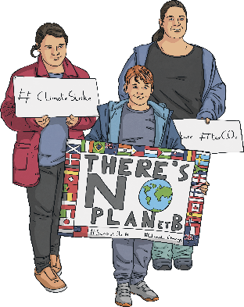
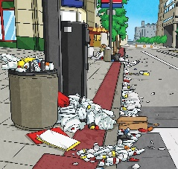
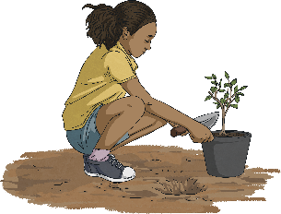
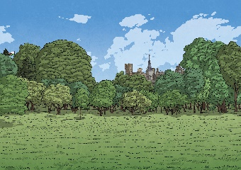
Volunteering
back
Volunteering is a great way to help your local community.
Can you think of any volunteering ideas?
litter picking
tree planting
helping to care for parks
spreading awareness about climate change
caring for bees and butterflies (this could be from the plants you have in your garden)
Another way you could help is to take part in the Global Earth Challenge. This is an online app that helps collect billions of observations in all sorts of environmental areas, such as air quality and plastic pollution. It provides scientists with valuable environmental understanding. You could take part in school, with each class recording different information about the local area.

Slide 15
Other
back
Can you think of any other ways we can help restore our earth?
As this year marks the 51st Earth Day, here are 51 tips and actions you can do throughout the year. Do your part for our planet!
https://www.earthday.org/earth-day-tips/
reflection

Slide 16
Reflection
Take a minute to have a think about these questions. You may want to close your eyes.
What do you think of when you hear ‘climate change’?
What things will you do to help restore our earth?
How would you feel if there were no plants or animals anymore?
What do you think of when you hear ‘our earth’?

Slide 17
We hope you find the information on our website and resources useful. This resource contains links to external websites. Please be aware that the inclusion of any link in this resource should not be taken as an endorsement of any kind by Twinkl of the linked website or any association with its operators. You should also be aware that we have no control over the availability of the linked pages. If the link is not working, please let us know by contacting TwinklCares and we will try to fix it although we can assume no responsibility if this is the case. We are not responsible for the content of external sites.

