Slide 2
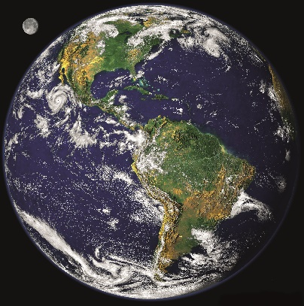
What Is Earth Day?
Earth Day takes place every year on April 22nd.
Since 1970, people all around the world have shown their support for the environment by becoming involved in Earth Day.
People in over 193 countries will take part in activities to help raise awareness of climate change and to protect the environment.
Did You Know?
The Earth was first photographed from space in 1978 by astronauts on Apollo 8.
Photos courtesy of (NASA Goddard Space Flight Center@flickr.com) - granted under creative commons licence – attribution.

Slide 3
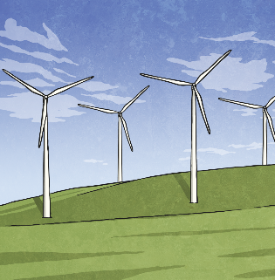
What Can We Do?
How can people help the Earth on Earth Day and throughout the year?
Mission 1
Plant trees.
Mission 2
Stop using fossil fuels and make cities run on renewable energy.
Mission 3
Build on momentum from the Paris Climate Summit.

Slide 4
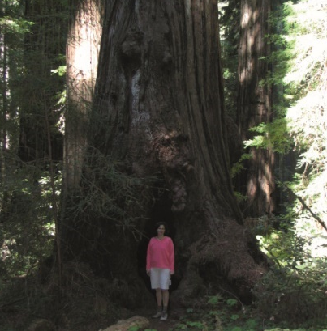
Mission 1: Why Trees?
Mission
The planet loses 15 billion trees each year. That’s an area the size of 48 football fields each minute! Trees are cut down for many reasons, but the main reasons are to make space for people to live and to clear land for farming. Trees are also used to make furniture and paper.
We need trees! They help to clean the air and provide oxygen, food, and shelter.
Can you think of a positive reason for cutting down trees? Can you suggest why we need to plant more trees?
Did You Know?
Trees can grow up to 300 feet high and live for thousands of years!
Photos courtesy of (Thomas Kriese@flickr.com) - granted under creative commons licence – attribution.

Slide 5
Trees Are Great!
Mission
Trees mitigate climate change and pollution by absorbing excess carbon dioxide and filtering pollutants from the air.
Trees improve biodiversity. Planting the correct trees can counteract species loss.
Trees support communities. They create better living spaces and can result in less trash and less crime.
Use a dictionary to find the definition of the words in blue. Try putting each word in a sentence of your own to show your understanding.
Fact: Just one mature oak tree can support as many as 500 different species!

Slide 6
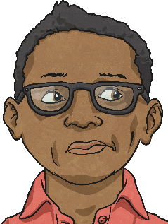
Definitions
Mission
mitigate
To make something bad less serious; to reduce or lessen the effects.
pollution
Introducing something to the environment that is poisonous or harmful.
biodiversity
The variety or number of different species in a particular habitat. Usually, a high number is thought to be a good thing.
communities
Groups of people living in the same place or having something in common. A community often has shared values and attitudes.
Well done! I wonder if you can arrange the words alphabetically?

Slide 7
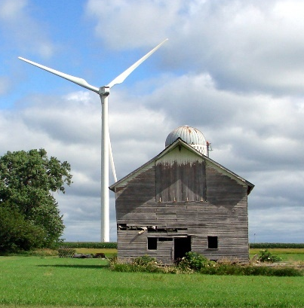
Mission 2: Why Renewable Energy?
Fossil fuels such as coal, oil, and gas were formed millions of years ago from living organisms. They are not renewable and will run out one day. They also produce carbon dioxide when they burn that leads to climate change.
Renewable energy comes from natural sources such as wind, sun, and water. It does not pollute air or water and has been used for thousands of years.
Talking Point:
Some people argue that wind turbines spoil their view of the countryside. Others argue that they help protect the environment. Have a debate in class - which point of view will you support?
Did You Know?
There is a large wind turbine in Hawaii. It is 20 stories tall and the blades are each the length of a soccer field!
Mission
Photos courtesy of (Don Graham @flickr.com) - granted under creative commons licence – attribution.

Slide 8
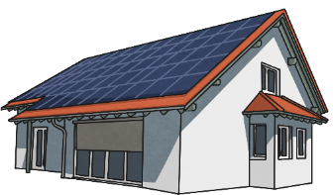
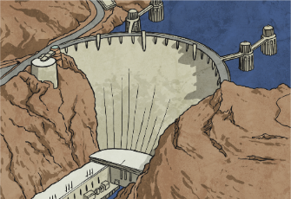
Renewable Energy
Mission
Solar energy comes from sunlight. Special solar cells convert light into electricity.
Windmills have been used for a long time. Today, wind farms are built on flat open spaces where the wind blows at around 14 mph.
Ancient Egyptians used water wheels to provide energy. Today, hydropower uses the energy of moving water to make electricity.
Using a map of your state, where do you think the best places for renewable energy would be? Use the Internet to help you research.
Fact: Spacecraft and the International Space Station use solar panels to generate power.

Slide 9
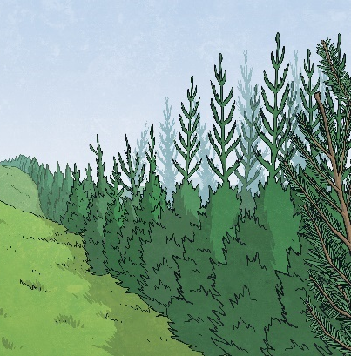
Mission 3: Paris Climate Summit – Tackling Climate Change
The Paris Climate Summit saw a gathering of more than 190 countries discuss ways in which the United Nations could reduce “greenhouse gases.”
One of the main decisions agreed upon was the need to reduce carbon dioxide emissions.
Carbon dioxide is a greenhouse gas that causes climate change. Climate change causes the Earth to warm up faster, changing the weather and the environment.
Can you find out which countries are part of the United Nations?
Did You Know?
Planting 96 trees would absorb the carbon dioxide from one person for a year!
Mission

Slide 10
The United Nation Countries
The USA belongs to the United Nations, along with many other countries from around the world.
Have a look at the full list on the United Nations website.
Now you have looked at the countries in the United Nations, can you match the flags for Spain, Ireland, and Jamaica?

Slide 11
The Effects of Climate Change
Mission
As the Earth’s atmosphere warms, the ice caps are in danger of melting. This can cause sea levels to rise and lead to loss of habitat.
Extreme weather means that the Earth experiences more floods, droughts, and storms. Weather affects people, farming, and the environment.
As climate changes, so do habitats. Many species are in danger of extinction as they lose their homes and/or when they cannot adapt to the new climate.
Did You Know?
It is said that when a child born today reaches 80 years old, the world will be 6 and a half degrees warmer. That might not sound a lot, but the planet only warmed by 7 degrees in the last 12,000 years! What does this tell you?
Fact: 90% of scientists agree that climate change is caused by humans!

Slide 12
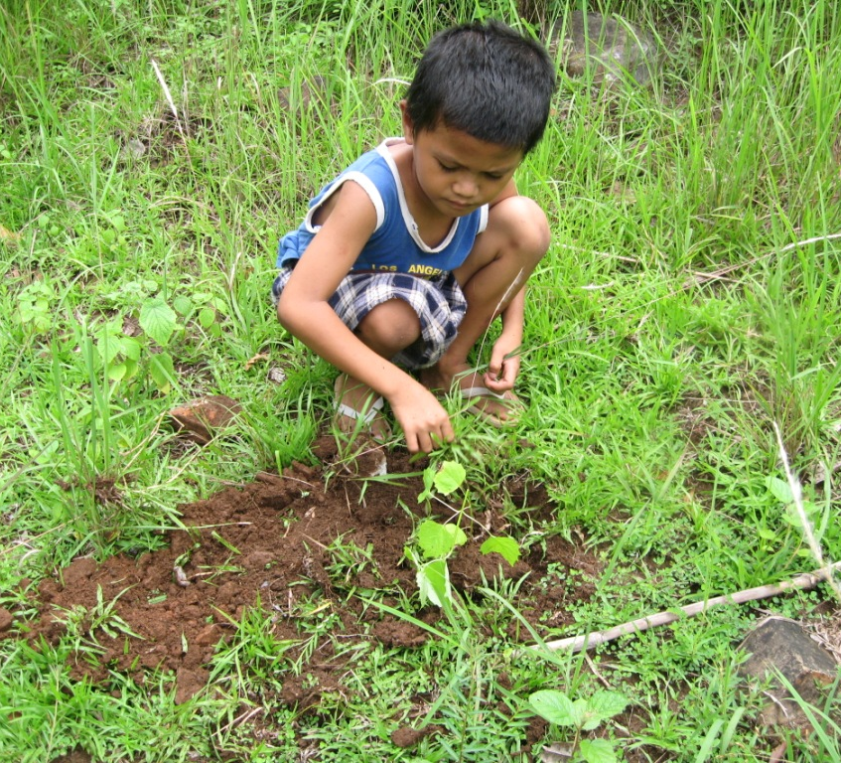
How Can You Support Earth Day?
Mission
Plant more trees!
As well as helping to tackle climate change by absorbing carbon dioxide, trees help us feel relaxed and healthy. They can even help you concentrate at school! Trees provide food and shelter to animals and provide a sign of seasonal change. By getting outside and planting trees, we can improve our mood and create a stronger sense of community. With such a huge variety of trees, you can plant trees for food, for medicine, for building material, or just because they are nice to look at! Go on, give it a try!
Photos courtesy of (Trees ForTheFuture@flickr.com) - granted under creative commons licence – attribution.

Slide 13
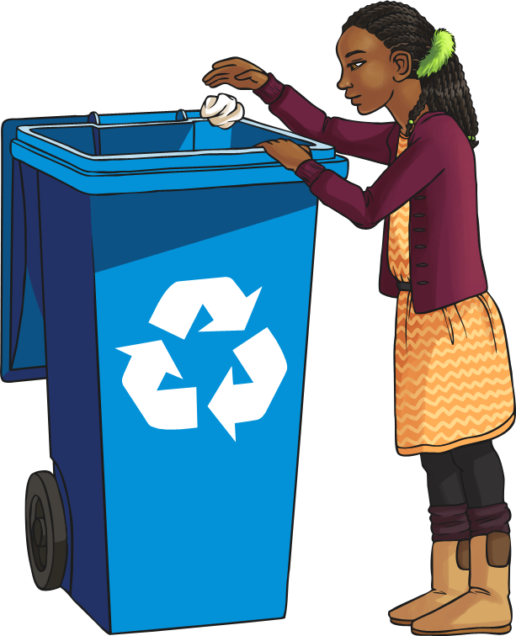
How Can You Support Earth Day?
Mission
Reduce, reuse, recycle!
Reduce the amount of trash you create - can you use reusable bottles and containers in your packed lunch? Try it!
Reuse items lots of times before you throw them away - can you write on both sides of your paper? Try it!
Recycle items you can’t use any more instead of throwing them away - clothes, paper, metal, glass - they can all be recycled!

Slide 14
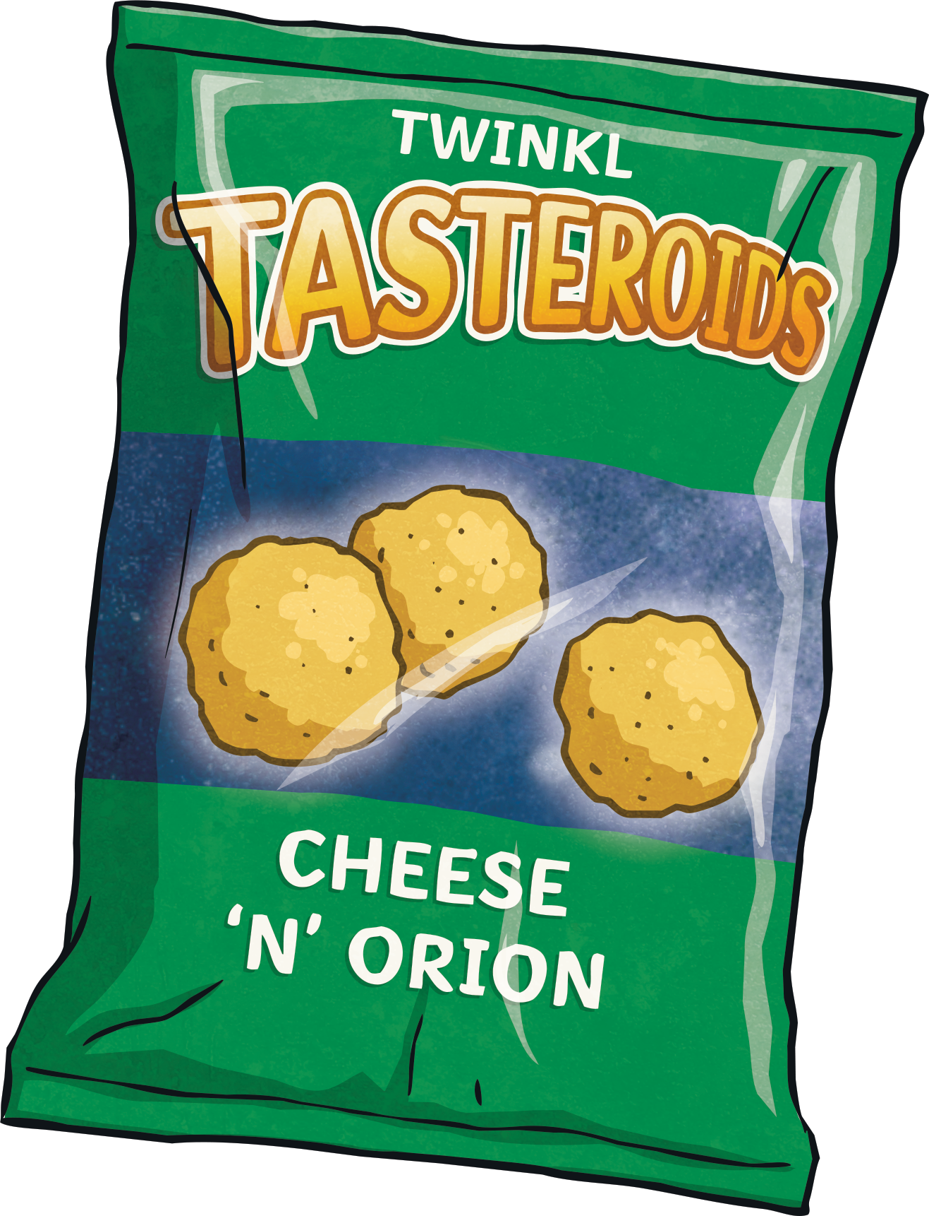
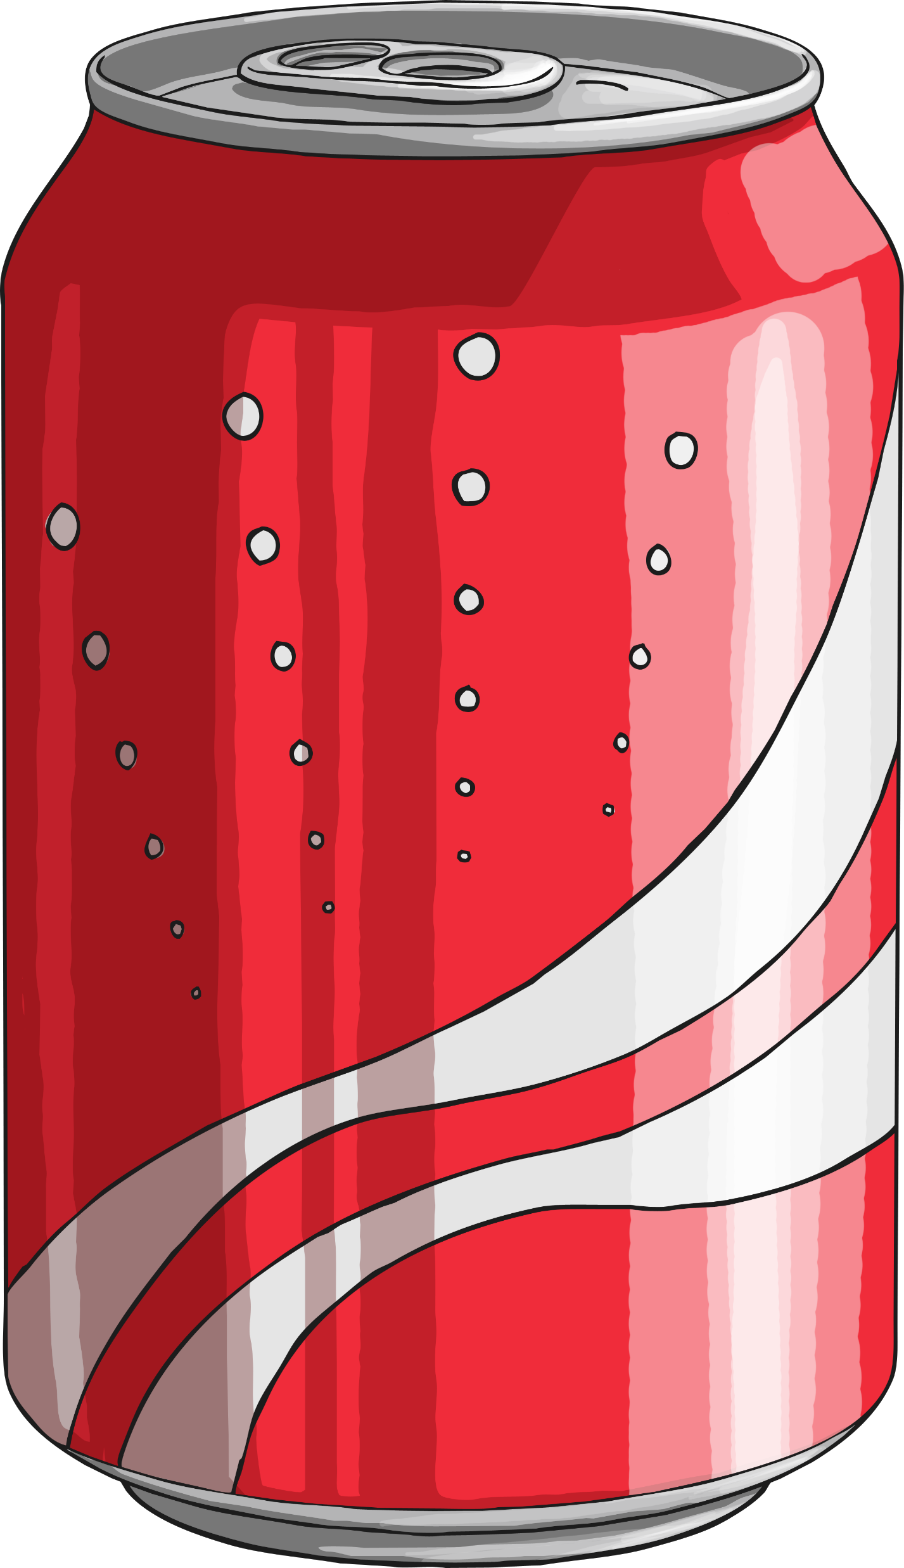
Sort the trash!
Recyclable
Non-Recyclable

Slide 15
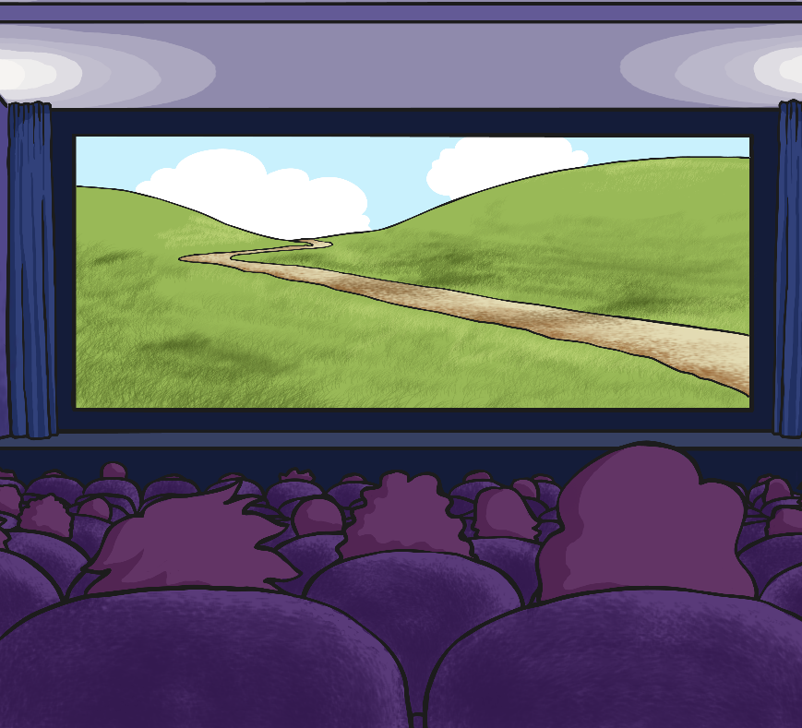
How Can You Support Earth Day?
Watch an environmentally-themed movie!
Do you want a greater understanding of the Earth Day message? Watch a movie with an environmental theme such as Wall-E, Happy Feet, or FernGully.
As well as having fun watching the movie, you’ll learn about caring for Planet Earth!
Mission

Slide 16
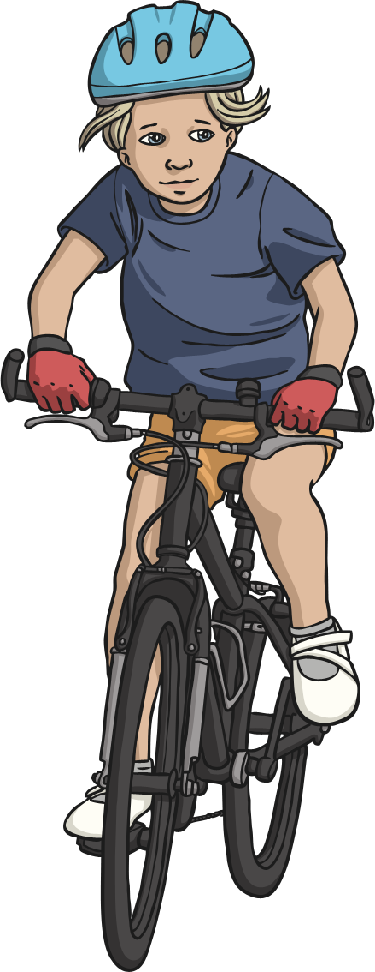
How Can You Support Earth Day?
Reduce your carbon footprint!
Your carbon footprint is the amount of carbon dioxide you release into the air. Everyone needs to use energy but how you choose to travel can produce more or less carbon dioxide.
Can you walk or cycle to school?
Why don’t you make a class graph to show how you travel to school over the course of a week? Make it a class mission to respect and protect your planet!

